Slide 1

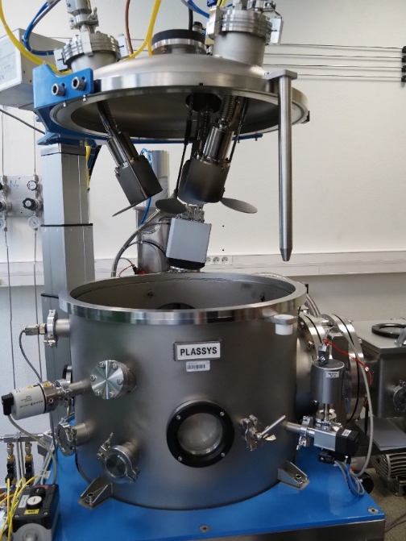
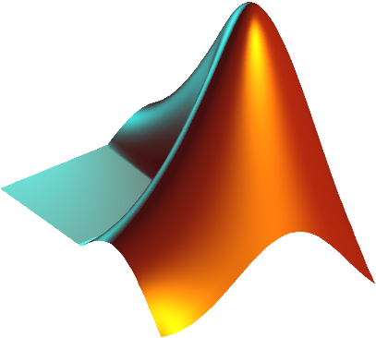
Machine learning
Multilinear regression
SVM
Random Forrest
Deep Learning: Neural Network PyterK
N-element alloy to optimize
➔ N-1 dimension space to explore
Experimental database
Composition | Property 1 | Property 2 | Property 3
Mixture design: simplexe centroide
Example on 3 and 4 elements composition space
A
A
AD
AB
AC
AB
ABD
AC
ACD
D
ABC
ABCD
ABC
BD
BCD
CD
Sample Analysis
B
BC
C
B
BC
C
A
A
AD
α
AC
AB
AC
AB
ABD
ACD
ABC
ABCD
D
BD
ABC
CD
BCD
B
BC
B
BC
C
C
Linear gradients passing by 3 points or 2D planes passing by 7 points
A
A
Cosputtering with magnetron sputtring: 2 or 3 cathodes
AD
AC
AC
AB
AB
ABD
ACD
D
EXACTNESS interface
Selection of gradients or planes depending on magneton cathodes number and user choices
ABC
ABCD
ABC
BD
BCD
CD
B
BC
C
B
BC
C

